Slide 1
Cloud Integration Developer’s Guide to Windows 10

Slide 2
Agenda
Connected Mobile Experiences
Roaming Data
Sharing State using OneDrive
Azure Mobile Apps
Creating an Azure Mobile Apps Service
Offline sync
Push Notifications

Slide 3
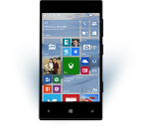
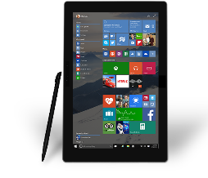
Evolution of Mobile Experiences
Reaching your customers in new and unique ways
Mobile “Devices” led to revolutionary Experiences
“Bring the experience with you”
Came with many constraints (small screen, battery, etc.)

Slide 4
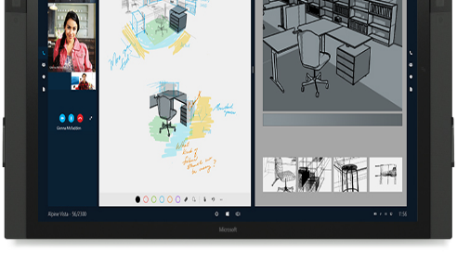
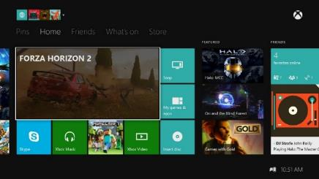
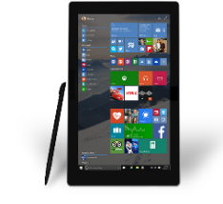
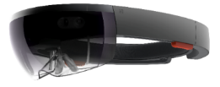

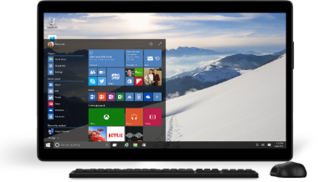
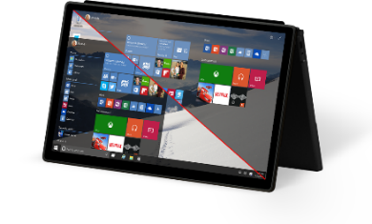
Mobile Experiences - not just mobile devices
The Experience you want on the device you want
User is the center of the experience, not the device.
Available on the right device at the right time
Input model optimized for the experience.
Enabling Mobile Experiences with Universal Apps
User

Slide 5
Create shared mobile experiences whatever the device

Slide 6
Roaming Data APIs

Slide 7
Using the Roaming settings
The RoamingSettings are exposed as a dictionary into which an application can save data
Note: On Windows Desktop, there is a special HighPriority key. This has no effect on Windows Mobile.
Windows.Storage.ApplicationDataContainer roamingSettings =
Windows.Storage.ApplicationData.Current.RoamingSettings;
roamingSettings.Values["userName"] = name.Text; var composite = new Windows.Storage.ApplicationDataCompositeValue(); composite["intVal"] = 1; composite["strVal"] = "string"; roamingSettings.Values["exampleCompositeSetting"] = composite;

Slide 8
Reading the Roaming settings
Query the roaming settings by using the key name
Windows.Storage.ApplicationDataContainer roamingSettings =
Windows.Storage.ApplicationData.Current.RoamingSettings;
if (roamingSettings.Values.ContainsKey("userName"))
{
name.Text = roamingSettings.Values["userName"].ToString();
}

Slide 9
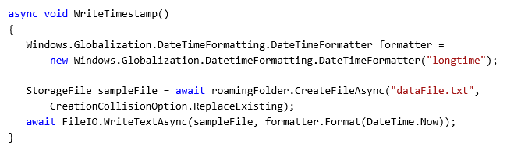
Roaming Folder
Use the roaming app data store to read/write files and folders

Slide 10
DataChanged notification
The DataChanged event fires when the roaming data has changed
Windows.Storage.ApplicationData.Current.DataChanged += Current_DataChanged;
...
void Current_DataChanged(ApplicationData sender, object args)
{
// Refresh your settings...
}
The event only fires if the application is active
You should still load up all your data when your app starts

Slide 11
Debugging apps using Roaming Data
Developers can install an application on multiple unlocked devices
Locking a developer device will trigger the synchronisation
If you have problems:
Make sure that files are closed correctly
Make sure that the devices are running the same version of the application

Slide 12
Demo: Roaming Data

Slide 13
Tips on using roaming data
Use roaming folder and roaming settings in the same way as local folder and settings
HighPriority setting is available on Windows Desktop for quick sync, but has no effect on Windows Mobile
Good for app customisation settings, most recent activity, partially completed work
Synchronisation stops if roaming data > 100KB
Bad for synchronising large amounts of data or “instant syncing” scenarios
Last writer wins
Data deleted from cloud if app not used for “a period of time” (~30 days)

Slide 14
Do not use Roaming Data as a general purpose data syncing mechanism

Slide 15
Credential Locker securely store and roam user credentials

Slide 16
Overview
APIs to store credentials (user name, password) securely
Windows.Security.Credentials
Benefits:
Secure storage
Credential isolation
Roaming

Slide 17

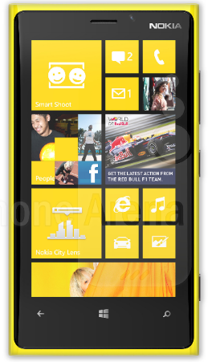
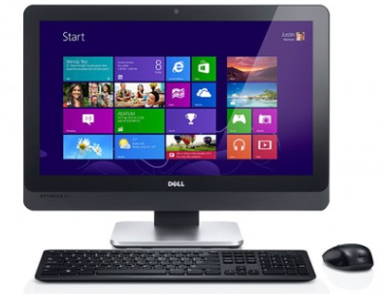
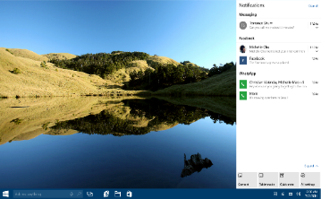


Roaming
Credentials roam across trusted devices
Uses public or business cloud according to primary user identity
MSA
App
App
AAD

Slide 18
Credential Locker sample
void SaveCredential(string username, string password) { PasswordVault vault = new PasswordVault(); PasswordCredential cred = new PasswordCredential("MyAppResource", username, password); vault.Add(cred); } IReadOnlyList<PasswordCredential> RetrieveCredential(string resource) { PasswordVault vault = new PasswordVault(); return vault.FindAllByResource(resource); }

Slide 19
Sharing State using OneDrive

Slide 20
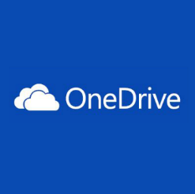
OneDrive Cloud Storage
OneDrive
Accessible cloud storage for personal documents, photos, and files that can be accessed from anywhere.
Best for user owned content.
OneDrive for Business
Secure enterprise grade storage for business documents and files.
Best for business / enterprise owned content.
Depending on your app targeting both is appropriate.

Slide 21
OneDrive Integration choices
Two pathways to light up OneDrive<->app integration
Pickers and savers for quick integrations.
Quickly open files from OneDrive and save files back.
Supported for JavaScript, iOS, Android, and Windows Universal apps.
OneDrive API for deeper / robust integrations.
Rich web API that enables all integrations with OneDrive.
First party applications built on this.
More information: //BUILD/ session 3-734
New OneDrive APIs for Developing Against OneDrive AND OneDrive for Business
http://channel9.msdn.com/Events/Build/2015/3-734

Slide 22
Demo: OneDrive File Access

Slide 23
Azure App Service Mobile Apps

Slide 24

App Service: one integrated offering
Web Apps
Mobile Apps
Web apps that scale with your business
Build Mobile apps for any device
LOGIC Apps
API Apps
Automate business process across SaaS and on-premises
Easily build and consume APIs in the cloud

Slide 25
App Service Platform View (Runtime)
API Apps
Mobile Apps
LOGIC Apps
Web Apps

Slide 26
App Service
Create web and mobile experiences that share data access and business logic
Automate business processes with logic apps
Build custom APIs or consume connectors from Marketplace
One common billing model for all of your App Services
Use a common Gateway to authenticate

Slide 27
Demo: Creating an Azure Mobile App

Slide 28
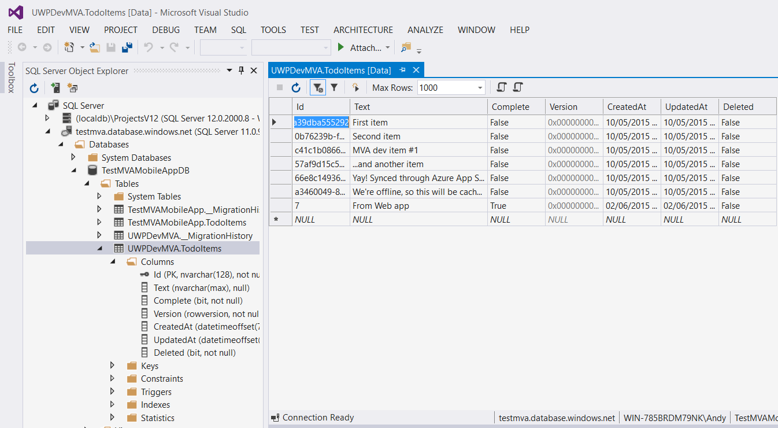
Mobile Apps Dynamic Schema
Very easy to configure backend data tables!
Create new table in backend store
Post Json from client
Table auto-configured with columns, plus sync tracking columns

Slide 29
Azure Mobile Offline data sync

Slide 30
The best mobile apps handle network interruptions gracefully

Slide 31
Adding offline sync to an app is usually hard. With Azure Mobile App, it’s easy.

Slide 32
Why use mobile offline sync?
Improve app responsiveness by caching server data locally on the device
Make apps resilient against intermittent network connectivity
Allow end-users to create and modify data even when there is no network access
Sync data across multiple devices
Detect and handle conflicts when the same record is modified by more than one client

Slide 33
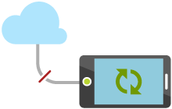
How it works
Access data from Mobile Services tables even when app is offline
Keep a local queue of Create, Update, Delete operations and synchronize with server when app is back online
Detect conflicts when same item is changed both locally and on server
Use soft delete to remove deleted records from client data stores
Can use push notifications to trigger client sync

Slide 34
Demo: Azure Mobile App Offline Sync

Slide 35







Handle client sync conflicts
Client
Conflict resolution
Server
Conflict resolution

Slide 36


Detect Conflicts with Optimistic Concurrency
Server
Device 1
Device 2
Create
▲, 1
▲, 1
▲, 1
▲, 1
Fetch
▲, 1
Update
▲, 1
■, 2
▲, 1
▲, 1
■, 2
Update
✘
●, 2
▲, 1
■, 2
■, 2

Slide 37
Summary: Azure Mobile offline sync
Supports both “primarily online” and “occasionally connected” scenarios
Explicit push and pull leaves control to the developer
Works with a variety of server data stores
SQL, Azure Tables, Mongo, Dynamics CRM, Salesforce, etc.
Cross-platform client SDKs
Windows Universal, Xamarin, iOS, Android
Flexible and powerful
Supports custom local storage layers
Detect and handle conflicts on server or client

Slide 38
Adding push notifications

Slide 39

Push Notifications 101
Register device handle at app launch
Client app retrieves handle from Platform Notification Service (PNS)
Client app sends handle to your custom backend
Send Notification
Your backend connects to PNS and requests push Your code has to manage scale Your code has to map between logical users and device handles
PNS pushes notification to device
Maintain backend device handles
Your code must delete expired handles when PNS rejects them
Your code must map between logical users and device handles
1
4
Client app
2
3
Platform
Notification
Service
5
App back-end
6

Slide 40


Azure Notification Hubs
Register device handle at app launch
Client app retrieves handle from Platform Notification Service
Client sends handle to your backend Backend registers with Notification Hub using tags to represent logical users and groups
Send Notification
Backend sends request to Notification Hub using a tag Notification Hub manages scale Notification Hub maps logical users/groups to device handles
Notification Hub delivers notifications to matching devices
Maintain backend device handles
Notification Hub deletes expired handles when PNS rejects
Notification Hub maintains mapping between logical users/groups and device handles
1
4
Client app
PNS
4
5
2
6
2
3
App back-end
Notification
Hub

Slide 41
Demo: Push Notifications

Slide 42
Try it now
Try Azure Mobile App for free!
No credit card required!
Go to aka.ms/TryMobileApp
Learn more
Go to aka.ms/AppServiceMobile
Tweet @azuremobile

Slide 43
Review
Connected Mobile Experiences
Roaming Data
Sharing State using OneDrive
Azure Mobile Apps
Creating an Azure Mobile Apps Service
Offline sync
Push Notifications

